Slide 1

Module 1: Physical Processes in Electric Utilities
Topic 1.2 Wind Energy Grid Integration
Manohar Chamana, Ph.D.
Instructor
National Wind Institute
Texas Tech University

Slide 2
Subtopics Covered
Wind Turbine Conversion Principles
Wind Turbine Mechanical System
Wind Turbine Electrical System
Wind Energy Grid Integration and Operation

Slide 3
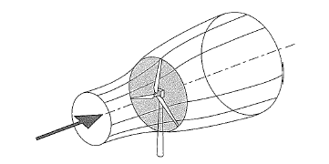
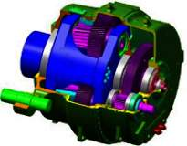
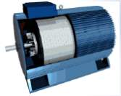
Wind Turbine Principles
Converting one form of energy to another
Kinetic Energy
Mechanical Energy
Electrical Energy
Component | Rotor | Gearbox | Generator | Converter
Efficiency | 45-52% | 95-97% | 97-98% | 96-99%
Overall: 42 – 50% Efficient Today… Theoretical Maximum is 59.3% (no losses)
3
Notes:
3
The basic functional principle of a wind turbine generation system concerns the conversion of kinetic (movement) energy of the wind into electrical energy.
This is done in two stages:
Kinetic energy ⎝ mechanical energy ⎝ electrical energy
The energy of the wind sets the rotor of the WTGS into motion.
The rotor is connected to the rotor shaft via the hub. The gearbox converts the slow rotational speed of the rotor shaft into a higher speed for the generator.
Finally, the generator converts the mechanical energy into electrical power.
The energy converters of a wind turbine generation system are thus the rotor and the generator.

Slide 4
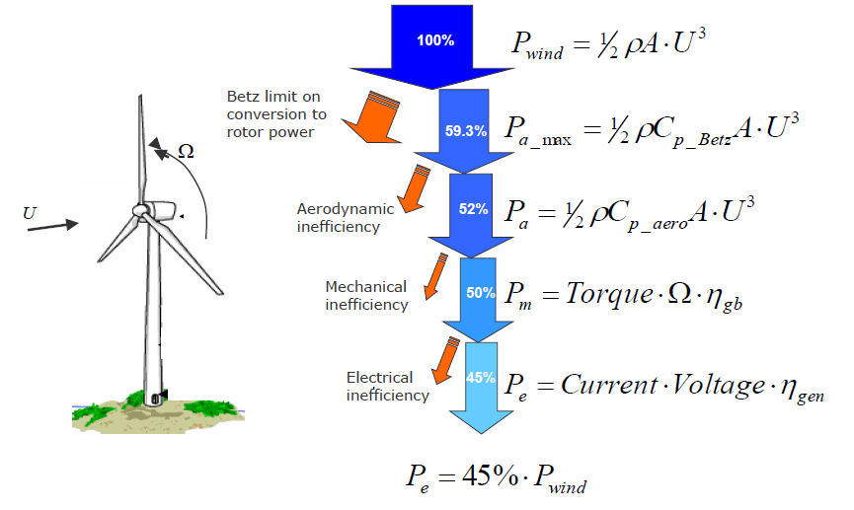
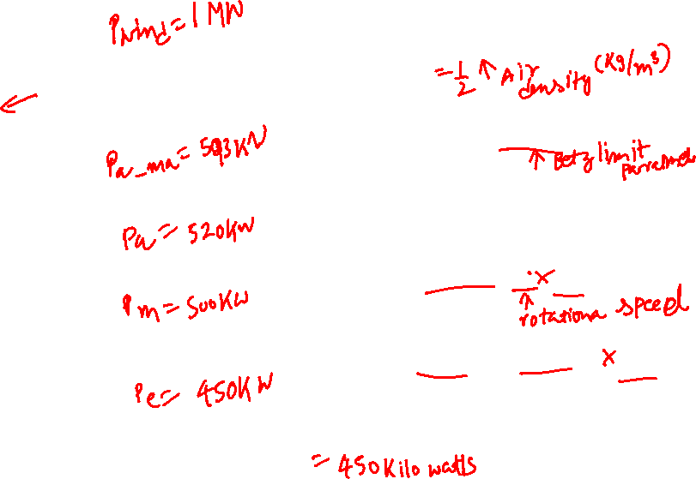
Why can’t we extract ALL the power in the wind?

Slide 5
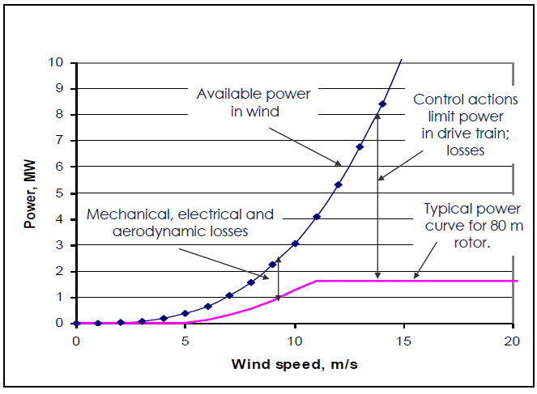
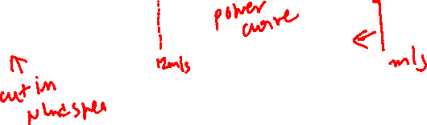
How much wind power do we extract?
Notes:
Mechanical Energy available in Blue
Power Curve in Pink

Slide 6
Wind turbine components

Slide 7
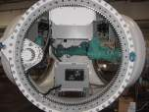
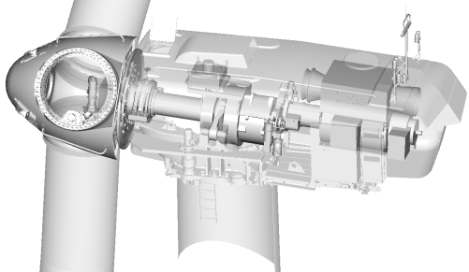
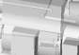
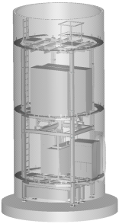
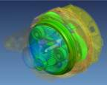
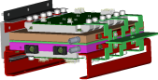
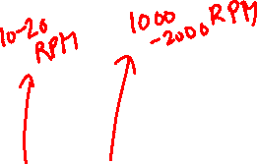
Wind Turbines
GE 1.5 MW
77 M Rotor Diameter
50-100 M Tower
98% Availability
Speed 10-20 RPM
Variable Pitch
Electrical Pitch
Drives
Doubly-Fed
Generator
Main Shaft &
Bearing
Gearbox
Epoxy-Glass
Composite Blades
Transformer &
Electrical
Power Electronic Converter

Slide 8
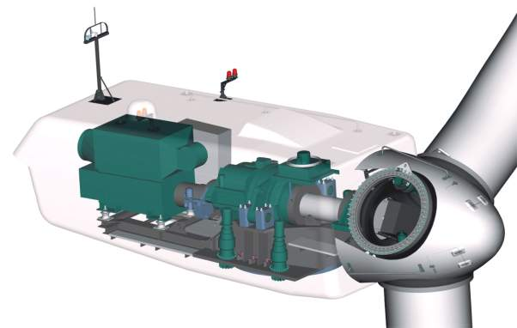
Nacelle & Hub components
‘Top box’:
low voltage, control…
GE 1.5 wind turbine
52 metric ton nacelle
35 metric ton rotor
Wind Sensors
High-speed coupling
Mechanical brake
Gearbox
Generator
Pitch drive
Pitch bearing
Bed Frame
Hub
Yaw drives
Yaw bearing
Rotor main shaft
Main bearing
8
Notes:
8
Each rotor blade can be turned using the pitch drive.
The drive train of the WTGS consists of the hub, the rotor shaft, the gearbox, the coupling, and the generator.
This is mounted on the ground frame. The rotor shaft is mounted in the main bearing.
The gearbox and the generator are noise decoupled to minimized the transmission of noise into the tower.
The gear oil is cooled using the oil cooler above a particular temperature.
The generator is cool with the chiller above it. In the so-called "top box" there is a small portion of the control system.
The yaw drives are used to turn the WTGS into the direction of the wind.

Slide 9
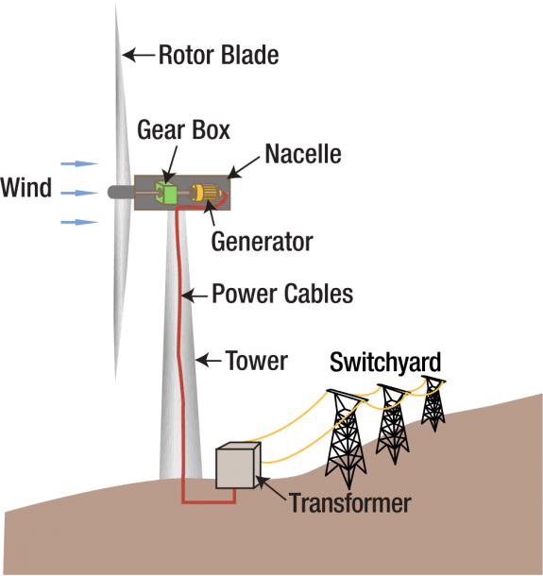

Design of Wind Turbines: Mechanical and Electrical System
Mechanical
Blades & Rotor
Drive train
Main Shaft & Gearbox
Pumps
Hydraulic
Motors
Yaw
Mechanical
Electrical
Electrical
Generator
Transformer
Down tower Cables
Controls
Top Controller
Bottom Controller
Hub Controller
Sensors
Notes:
WTG
Muscle that pitches wind-turbine blades comes primarily from hydraulics

Slide 10
Mechanical system

Slide 11
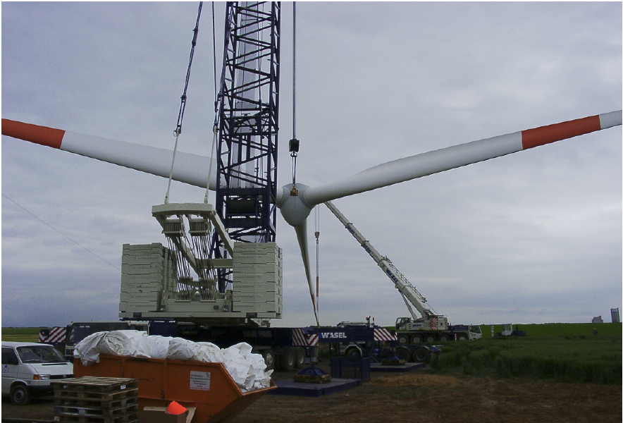
Rotor
The assembly of blades, hub, pitch actuators, and spinner are commonly called “The Rotor”

Slide 12
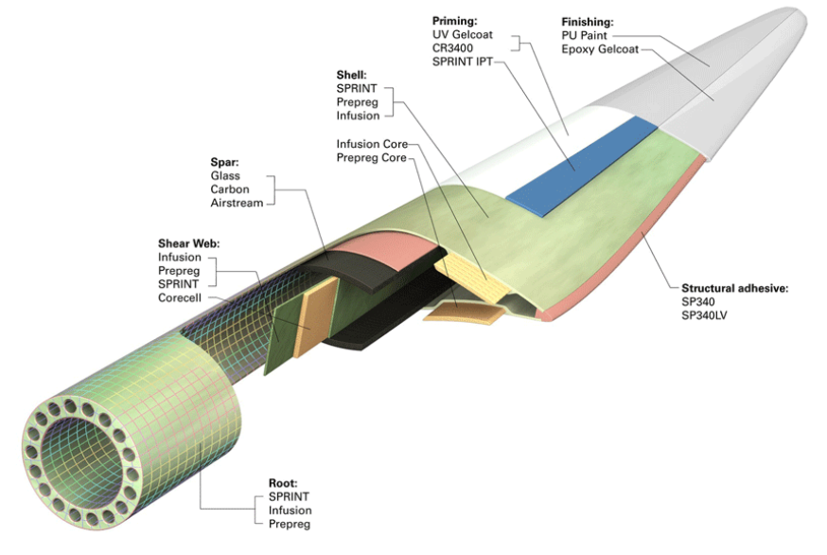
Blades
Glass Reinforced Polyester blade components:
Airfoil shape and tip design
Skew or twist along length from tip to root
Root & Root Bearing
Chord or Spar
Shell
Notes:
Materials
Metals, used on only small-scale turbines due to weight and metal fatigue –Aluminum and Steel
Fiberglass (Prepreg), glass fiber reinforced polyester or epoxy
Carbon Fibers, Kevlar (Aramid)
Wood (Birch)
Paint and surface treatments for corrosion protection

Slide 13
Blade pitch system
Maintain optimum blade orientation
Safety shut-down system
Electric or hydraulic Controlled
Pitch components mounted inside hub
Independent blade pitch
Controlled via turbine control unit

Slide 14
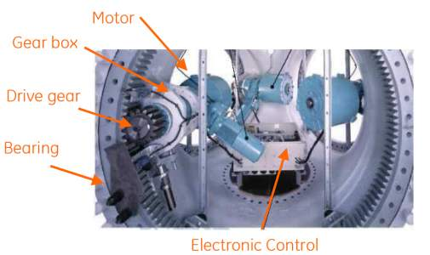
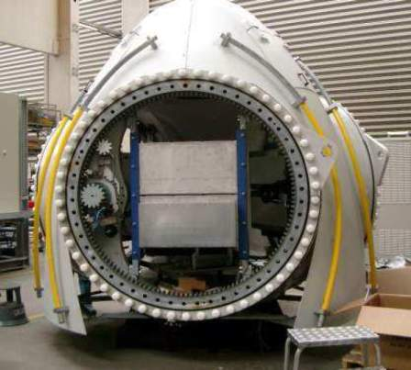
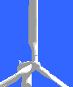
Hub & Pitch system
Hub Assembly
Source: GE energy – 2007 Sandia reliability conference
Pitch system… critical to safety
Pitch blades out of the wind
Maintain rated power
Shut turbine down
Source: GE energy – 2007 Sandia reliability conference
14
Notes:
The hub is a single die cast unit, used as a structural frame to transmit the torque created from the blades to the main shaft
It houses components such as the pitch actuators, linkage and controller
It is covered by the spinner

Slide 15
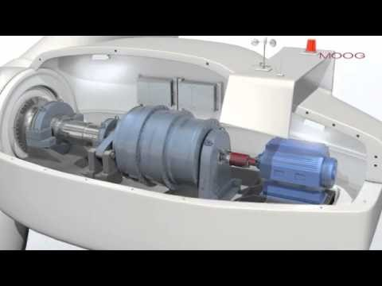
Commercial Pitch Controller

Slide 16
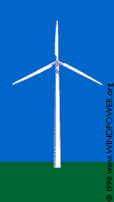
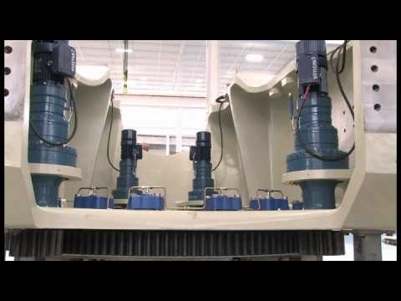
Yaw Control
Yaw refers to the rotation of the entire wind turbine in the horizontal axis.
Yaw control ensures that the turbine is constantly facing into the wind to maximize the effective rotor area and, as a result, power.
Because wind direction can vary quickly, the turbine may misalign with the oncoming wind and cause power output losses.

Slide 17
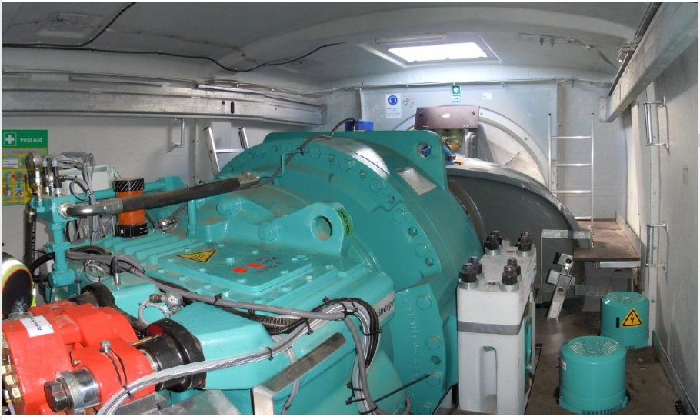
Secondary Braking System Similar to Parking Brake
Credits: Chris Elkinton

Slide 18
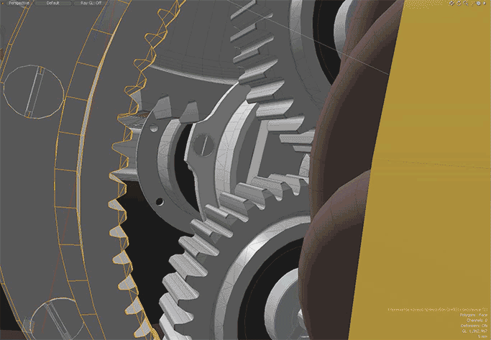
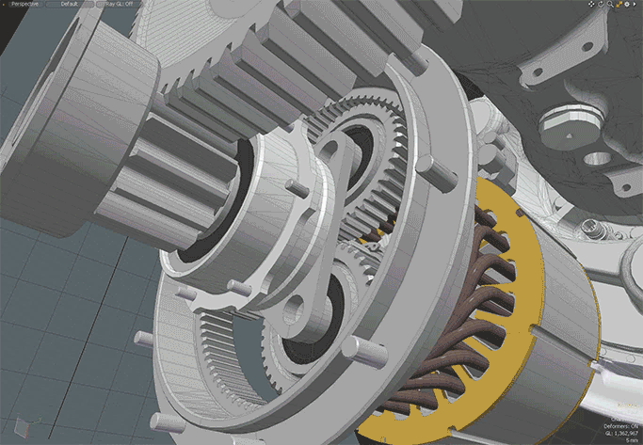
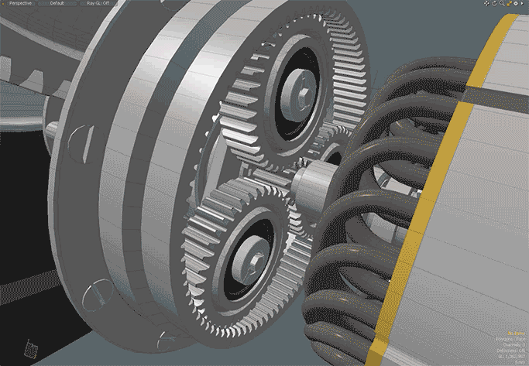
Single-Stage Planetary Gearbox
Gear Connected to low speed shaft
Armature Coils
Internal Gear
Electrical Generator
Planetary Gear
Sun Gear
Credits: Mike Mitsik

Slide 19
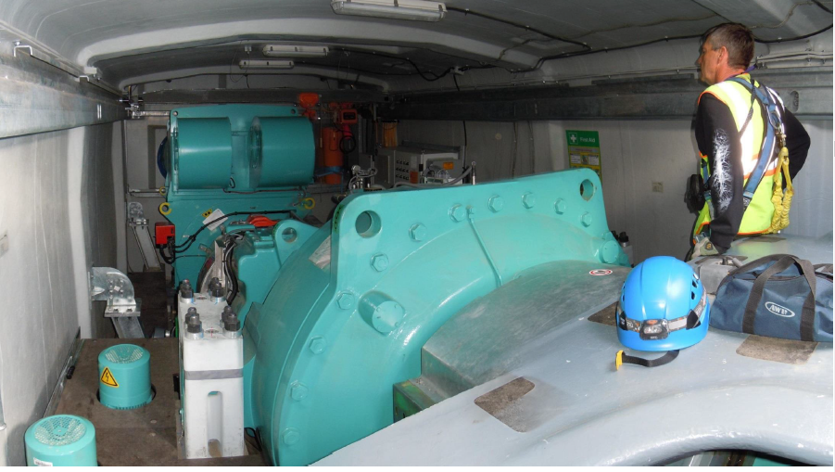
Gearbox and Generator View
Credits: Chris Elkinton

Slide 20
Electrical systems

Slide 21
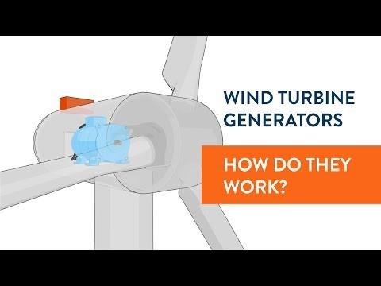
Wind Turbine Generator

Slide 22
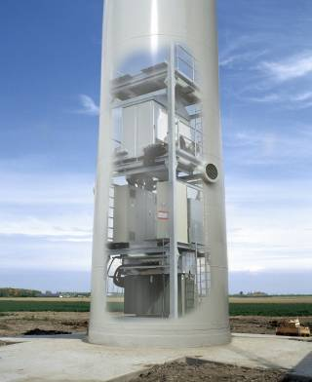
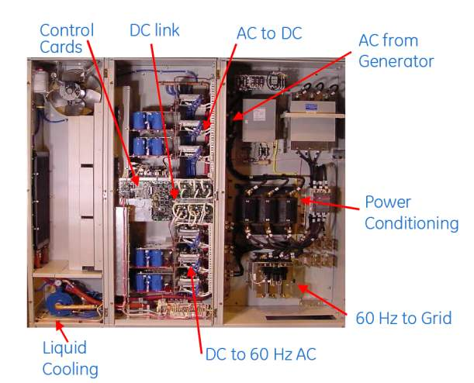
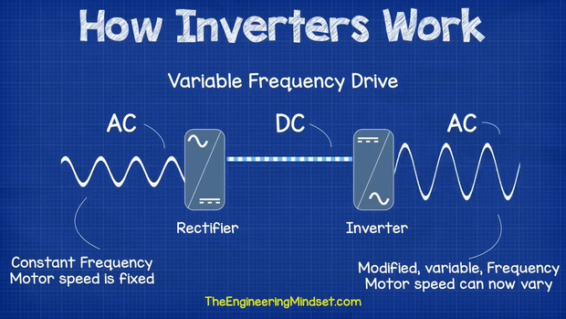
Tower and Power Electronics
Source; GE Energy
View of 2.5MW tower base
Power conversion… critical to flexibility
Grid integration and compliance
Variable speed capability
22
Source: GE energy – 2007 Sandia reliability conference
Notes:
22

Slide 23
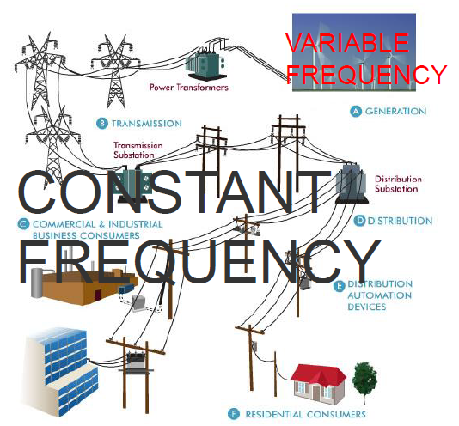
The electrical grid

Slide 24
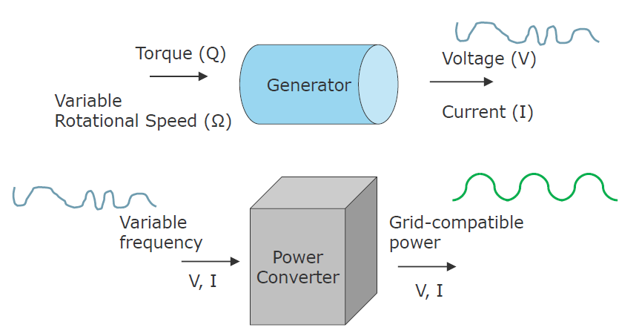
Generators and converters – function
Design choices?

Slide 25
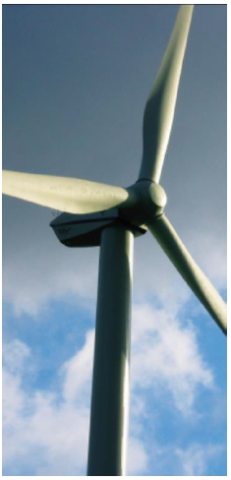
Two basic generator types
Synchronous Generator (incl. Permanent Magnet)
Generator speed matches grid (synchronized)
Common in large power generation
Asynchronous (Induction) Generator
Power lags rotational speed of generator
More common in wind turbines

Slide 26
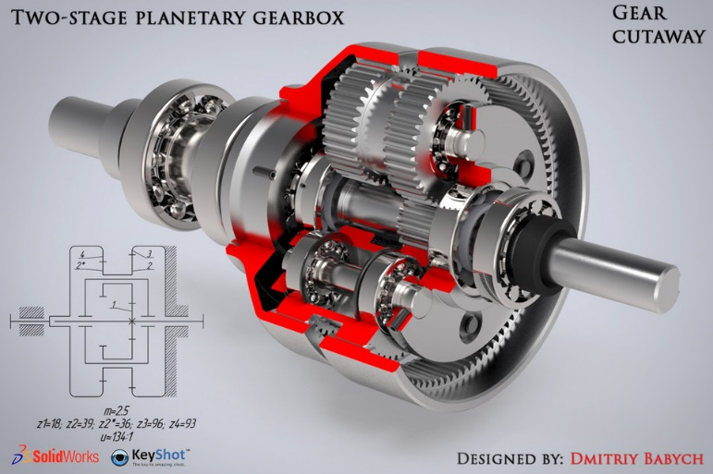
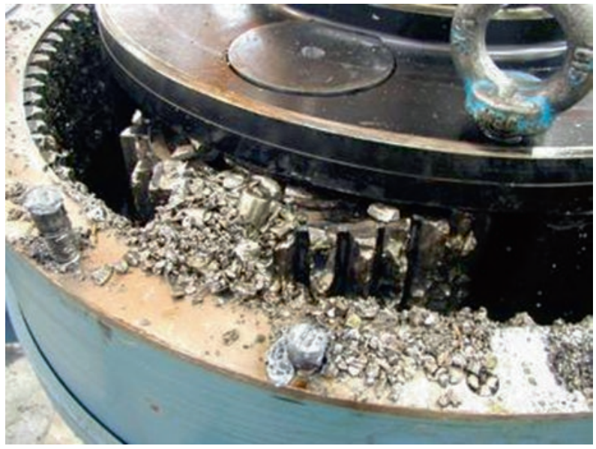
Direct Drive Wind Turbines
Why Direct Drive?
Gearbox problems are responsible for many turbine failures.
Lifetime of the gearboxes sometimes does not reach 5 years.
Its replacement creates cost of up to $200,000 for a 1.5 MW turbine which is more than 10% of the turbine investment cost.
Typical gearboxes are 2-3 stages Planetary gear boxes type
Fig Gearbox failure

Slide 27
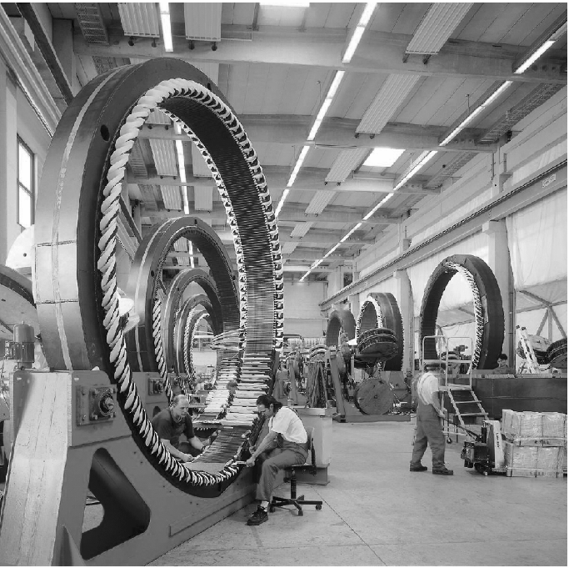
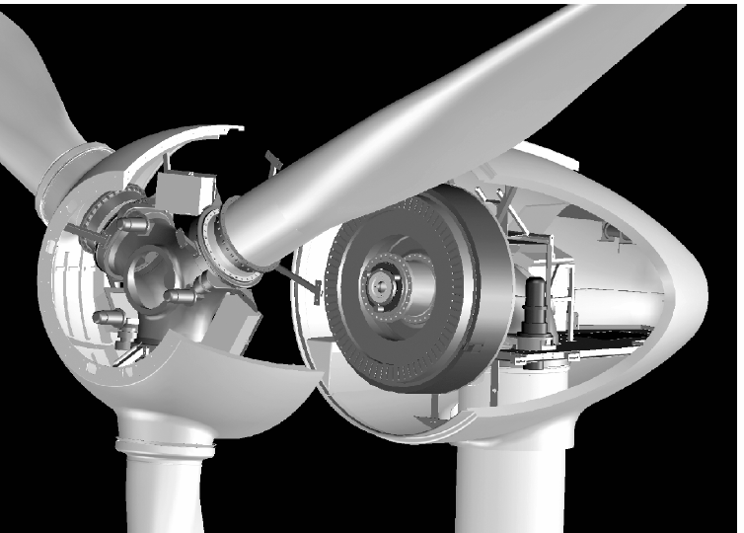
Directly Rotor-Driven Variable-Speed Generators
Direct-drive multi-pole synchronous generator of the Enercon E-30
Generator requires large number of poles to reach the grid frequency that the generator diameter and weight assume unacceptable dimensions
Production of synchronous multi-pole generators by Enercon

Slide 28
Turbine Step-Up Transformer
Generation within turbine at low voltage (≤1000 V)
Collection system at medium voltage (10-35 kV)
Oil-Filled Pad-Mount versus Dry-Cast Nacelle Mount
Medium Voltage Cable routings
Delta versus Wye Connections

Slide 29
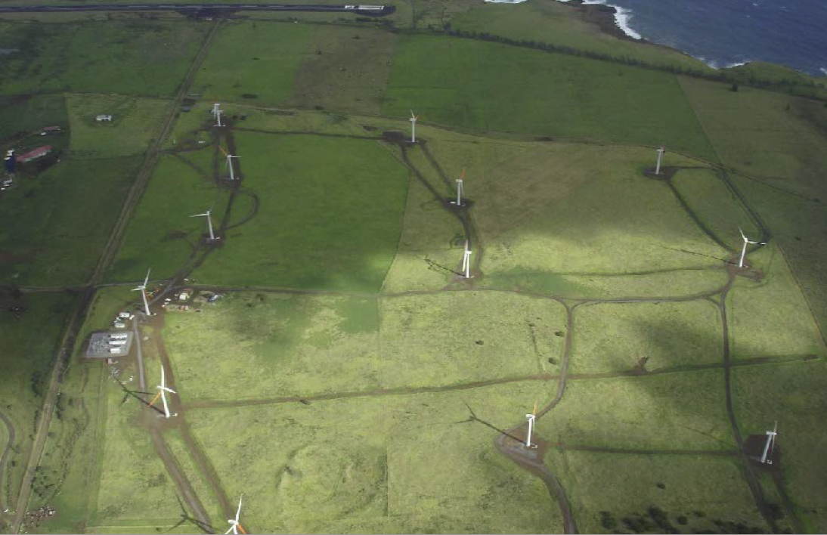
Design of MV Collection System

Slide 30
Wind energy grid integration and operation

Slide 31
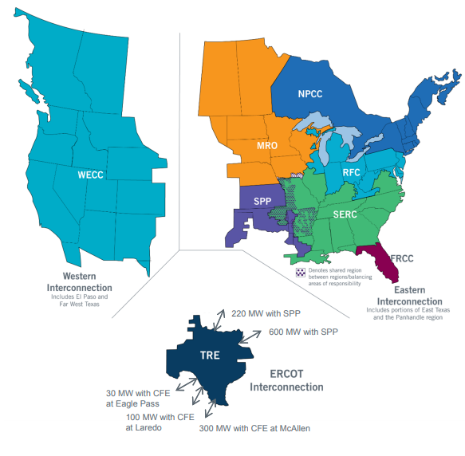
The ERCOT Region
The interconnected electrical system serving most of Texas, with limited external connections
90% of Texas electric load; 75% of Texas land
Load- 71,110 MW peak, August 11, 2016
More than 46,500 miles of transmission lines
16,022 MW wind generation record (instantaneous), December 25, 2016
570+ generation units

Slide 32
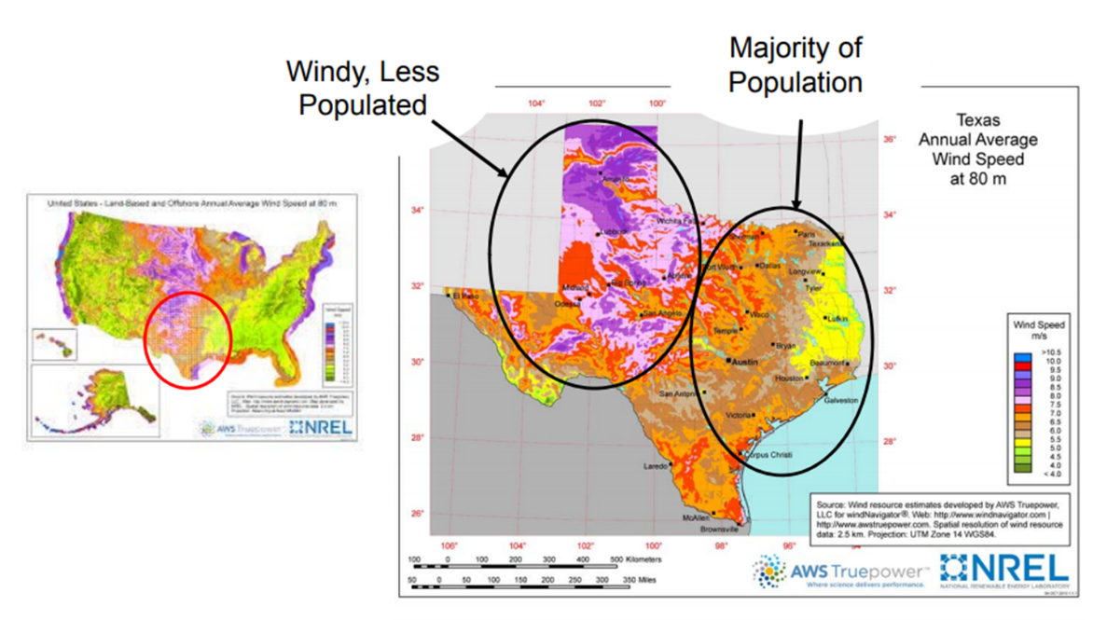
The ERCOT Region Wind Energy Integration
Texas Grid - ERCOT
Wind Generation: Techno-Economic-Policy related impacts in Texas
Addition of new transmission lines-CREZ

Slide 33
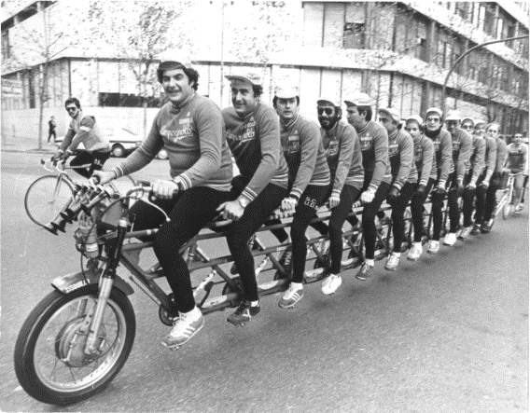
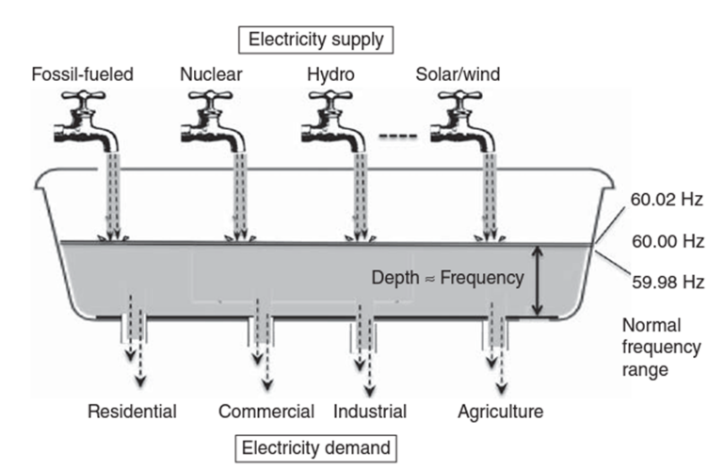
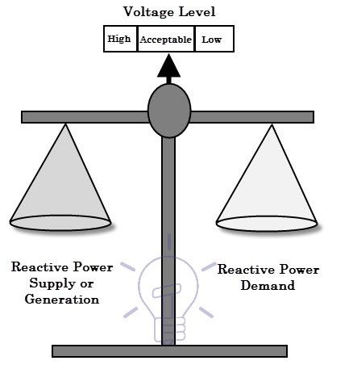
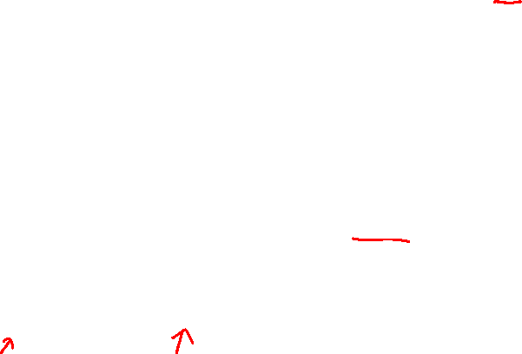
Power systems objectives
Real/Active Power is Balance ensured frequency stability.
Imaginary/Reactive Power is Balance ensures Voltage stability.

Slide 34
Conclusions
Wind Turbine Conversion Principles: From Wind Energy to Electrical Energy has been covered.
Wind Turbine Mechanical Systems including turbine blades movement and gearboxes covered.
Wind Turbine Electrical Systems including Generator, Power Electronics, Transformers and Lines Covered.
Wind Energy Grid Integration and Operation requirements covered.

Slide 35


